Slide 1

MACHINE LEARNING ACCELERATOR
Natural Language Processing – Lecture 1

Slide 2
Course Overview
Lecture 1
Lecture 2
Lecture 3
Day 2:
Introduction to Machine Learning and NLP
Text Processing
Bag of Words (BoW)
Single Layer Neural Networks
Day 2:
Multi Layer Neural Networks
Word Vectors
Recurrent Networks
AWS Services
Day 2:
Long Short-Term Memory Networks
Sequence-to-sequence Models
Transformers
BERT

Slide 3
What should you be able to do when you leave this class?
Fundamental understanding of data preprocessing, commonly used machine learning (ML) algorithms, and model evaluation
Practical knowledge of natural language processing (NLP) specific model training and applications
Be comfortable talking with data science partners
Find and leverage many valuable and useful ML resources in your own work

Slide 4


Machine Learning Resources
D2L: An interactive deep learning book with code, math, and discussions.
Learning ML
Ask technical questions with Tags,
https://sage.amazon.com/tags/MLU
Working with ML
Notebooks to build, train, and deploy machine learning models quickly
Notes:
We can only cover so much in this accelerated dive into ML, so
check out the open-source (text)book, Dive into Deep Learning at D2L.ai
Amazonians’ attempt to make ML, and in particular DL, approachable with Jupyter notebooks.
The most important thing in ML is writing code and experimenting hands-on
Jupyter Notebook is the most popular tool for doing DS/ML in Python
This is what we will be using throughout this course,
on AWS SageMaker Notebook instances
And, if you are going through this course with a group of ML enthusiasts, being in a classroom or online,
- collaborate, share ideas and experiments, learn from each others mistakes and successes,
to quickly build expertise with these new tools and techniques.
Also, please go ahead post your technical question to Sage, using MLU or D2L tags, to leverage the knowledge of the larger Amazon ML community.

Slide 5


Final Project
Apply and experiment with a real-world Amazon dataset.
Compete in the following challenge (your final project)
https://leaderboard.corp.amazon.com/tasks/352
Contest is open until
Sunday 5:00 PM (PST)
Top 3 submissions - this week
Completions

Slide 6
Final Project – Product Safety
Our dataset is made of product reviews that contains the word “burn” or its different forms such as: “burning”, “burnt”, etc.
We will classify them as safety issue or not safety issue.
Motivation:
One of Amazon Compliance’s missions is to protect Amazon customers from products that are potentially dangerous and contribute to build customer trust by ensuring safe, consistent, wholesome products.
The Food Safety team identifies and annotates customer reviews for potential issues.

Slide 7
Topics for Today
Introduction to Machine Learning
Introduction to NLP
Text Processing
Bag of Words (BoW) Representation
Single Layer Neural Networks
Final Project

Slide 8
Introduction to Machine Learning
Notes:
Let’s start with some introduction into this topic

Slide 9
What is Data Science?
Machine Learning
“a multi-disciplinary field that uses scientific methods, processes, algorithms and systems to extract knowledge and insights from structured and unstructured data.”
MACHINE LEARNING
MATHEMATICS
COMPUTER
SCIENCE
DATA
SCIENCE
STATISTICAL
RESEARCH
DATA
PROCESSING
DOMAIN
EXPERTISE
https://en.wikipedia.org/wiki/Data_science
Notes:
Wiki describes DS as…
For example, if you’d like to place a lunch online order
and you’d try to estimate beforehand whether or not the order would arrive on time or be late,
you’d most probably try to base your prediction on previous experiences.
You maybe collected data on previous orders,
organizing it in a way so that it can be easily analyzed for making decisions, performing various tasks on the data trying to figure out the outcome…
Now, what you have done is Data Science right there!
Note the multidomain expertise of data scientists,
data collection/processing, statistical exploration, domain expertise
Along with math and computing
Speaking of math and computing,
both buzzwords data science and machine learning have garnered a similar level of interest,
though machine learning was a little higher recently.

Slide 10
What is Machine Learning?
“Programming computers to learn from experience should
eventually eliminate the need for much of this detailed
programming effort”
Arthur Samuel (1959) – Computer Scientist
Notes:
What is Machine Learning?
Arthur Samuel, an American computer scientist, IBMer and pioneer of the field of AI, coined the term in 1959 by stating that
In other words, ML is teaching a machine to do a task,
though algorithms that can learn from data without relying on rules-based programming.
That sounds very similar to classical programming
the key difference is that in programming, you need to provide an exact recipe (code)
that tells the machine what rules to apply to solve a problem and provide answers.
In ML you also provide some code (instructions, ML algorithm),
but that code will tell the machine how to learn based on previous examples (historical data with - when possible - answers)
this code is then used to create a ML trained model
that will further be used to provide answers on new similar data
WHY ML? Why ML got so popular recently?
Some programs/solutions to problems are difficult or impossible to write explicitly
We may quite frankly not know how (task too complex), e.g., face recognition
Or there might be too much relevant data to examine, especially given recent explosion in data collection and data storage

Slide 11
How is ML Different From Classical Programming?
Problem
Classical Programming (If/else, etc.)
Answers
Rules
Problem
ML Algorithms
Trained ML Models (Rules)
Answers
Answers
New Similar Problem
Notes:
What is Machine Learning?
Arthur Samuel, an American computer scientist, IBMer and pioneer of the field of AI, coined the term in 1959 by stating that
In other words, ML is teaching a machine to do a task,
though algorithms that can learn from data without relying on rules-based programming.
That sounds very similar to classical programming
the key difference is that in programming, you need to provide an exact recipe (code)
that tells the machine what rules to apply to solve a problem and provide answers.
In ML you also provide some code (instructions, ML algorithm),
but that code will tell the machine how to learn based on previous examples (historical data with - when possible - answers)
this code is then used to create a ML trained model
that will further be used to provide answers on new similar data
WHY ML? Why ML got so popular recently?
Some programs/solutions to problems are difficult or impossible to write explicitly
We may quite frankly not know how (task too complex), e.g., face recognition
Or there might be too much relevant data to examine, especially given recent explosion in data collection and data storage

Slide 12
Machine Learning Lifecycle
Answer
New Data/Re-training
Deployment
Business Problems
Data Processing
Data Collection
Data Preprocessing
Data Visualization
Data Augmentation
Feature Engineering
Etc.
Yes
Model
Training
Tuning
Evaluation
Etc.
Meets
Business
Goal?
ML Problem Formulation
No
Notes:
If you identified an ML scenario,
how to do ML? what are the steps to follow?
Putting it all together here as ML Lifecycle, a preview of how much work is ahead
As mentioned, all starts identifying a Business Problem and formulate the ML Problem
This is a step not to taken lightly,
As Albert Einstein said: “If I had an hour to solve a problem I'd spend 55 minutes thinking about the problem and 5 minutes thinking about solutions.”
Once settled on the ML Problem, the next step is also time consuming:
Get all relevant data in one place, cleaned and processed,
ready to be used to train-tune-validate an ML model
that can be deployed and used in production to produce the desired outcomes, if meets the business goals,
or can be tweaked further until meets the bar, otherwise.

Slide 13
What’s the difference between supervised and unsupervised learning?
Supervised = Machines are taught using labeled data
Unsupervised = Machines are designed to learn the patterns in the data without labels

Slide 14
Supervised Learning: Regression
Supervised Learning
Price
SqFootage
Regression (Quantity)
Classification (Category)
Label
Features
Price | Bedrooms | SqFootage | Age
280.000 | 3 | 3292 | 14
210.030 | 2 | 2465 | 6
… | … | … | …
Notes:
Very popular Supervised Learning problem type, regression aims to learn relationships and correlations between input features and a continuous output variable,
with the scope of predicting the continuous output variable.
For example, the price of a house corresponds to a certain combination of no of bedrooms, sqfootage, age and so on.
Shown here, a linear regression model, assuming the relationship between the price and sqFootage is linear, that is a straight line.
- as sqf increases the price of the house increases.
Given historical data, prices of houses with these characteristics on the market,
one can learn such a model that can be later used to predict the sale price of a new given home based on its descriptors.
Some ML algorithms that can be used to build such models, are listed here:

Slide 15
Supervised Learning: Classification
Class 1 = star
Class 0 = not star
Supervised Learning
Feature 2
Feature 1
Regression (Quantity)
Classification (Category)
Label
Features
Star | Points | Edges | Size
1 | 5 | 10< | 750
0 | 0 | >9 | 150
… | … | … | …
Notes:
If you’d rather be interested to know whether the house given its characteristics was sold or not, that would be what’s called classification.
The other very popular Supervised Learning problem type, classification aims to learn relationships between input features and a output variable,
with the scope of separating the data into classes/groups.
For example, the star or not star classes correspond to a certain combination of no of points, edges and size here…
Shown here, a binary classification scenario, that is we only have two classes.

Slide 16
Unsupervised Learning: Clustering
Unsupervised Learning
Feature 2
Feature 1
Features
Clustering
package_weight | package_height | package_width
21.2 | 11.2 | 25.7
47.2 | 5.3 | 13.6
… | … | …
Notes:
One example of UL is clustering,
That involves grouping unlabeled data points according to their features/attributes.
For example, clustering can be used in market segmentation;
where we try to find customers that are similar to each other whether in terms of behaviors or attributes.

Slide 17
Training Models: Splitting data into sets

Slide 18
Training – Validation – Test Sets
Learning
Training Set
(used to train the model)
Train, tune and validate the model (multiple times!)
Training Set
Original Dataset
Validation Set
(used for unbiased evaluation of the model)
Testing
Test Set
Test Set
(used for final evaluation of the model)
(Final) Test the model
Notes:
We usually use three different sets from our dataset to train, validate and test our ML models. The scope of learning is not to repeat something you’ve seen and learned well, but rather how to generalize what you learned to unseen similar data.
In other words, we’re not ultimately interested in training performance/error, we’re interested in test performance/error (performance/error on new data). One way to ensure your model learning from some dataset will perform well on other similar dataset is to explicitly build, train, evaluate and test your model on different datasets!
We do this by using three separate sets: Training, Validation and Test sets. Training set is used to train the model. Test set is used to test the model at the end. Validation set is used model tuning part. In this part, we try to find the optimum structure of a model or select a model from multiple candidates. Like we said before, performance on unseen data is important. Here, the selections are done according to the validation set performance. The model doesn’t see the validation labels or learn from them.

Slide 19
Training – Validation – Test Sets
Learning
Training Set
(used to train the model)
Train, tune and validate the model (multiple times!)
Training Set
Original Dataset
Validation Set
(used for unbiased evaluation of the model)
Testing
Test Set
Test Set
(used for final evaluation of the model)
(Final) Test the model
review text | summary | verified | isPositive
PURCHASED FOR YOUNGSTER WHO\nINHERITED MY "TOO... | IDEAL FOR BEGINNER! | TRUE | 1
unable to open or use | Two Stars | TRUE | 0
Waste of money!!! It wouldn't load to my system. | Dont buy it! | TRUE | 0
I attempted to install this OS on two differen... | I attempted to install this OS.. | TRUE | 0
I've spent 14 fruitless hours over the past tw... | Do NOT Download. | TRUE | 0
I purchased the home and business because I wa... | Quicken home and business .. | TRUE | 0
The download doesn't take long at all. And it'... | Great! | TRUE | 1
Training Set
It is good practice to shuffle the dataset before the split to avoid bias in the resulting sets.
Validation Set
Test Set
Notes:
We usually use three different sets from our dataset to train, validate and test our ML models. The scope of learning is not to repeat something you’ve seen and learned well, but rather how to generalize what you learned to unseen similar data.
In other words, we’re not ultimately interested in training performance/error, we’re interested in test performance/error (performance/error on new data). One way to ensure your model learning from some dataset will perform well on other similar dataset is to explicitly build, train, evaluate and test your model on different datasets!
We do this by using three separate sets: Training, Validation and Test sets. Training set is used to train the model. Test set is used to test the model at the end. Validation set is used model tuning part. In this part, we try to find the optimum structure of a model or select a model from multiple candidates. Like we said before, performance on unseen data is important. Here, the selections are done according to the validation set performance. The model doesn’t see the validation labels or learn from them.

Slide 20
Model Evaluation
Notes:
Let’s talk about Machine Learning Model Evaluation
How do we know whether the Mach Learning model we built, trained and used to make predictions with, is actually a good model?
How do we evaluate ML models?
What metrics are there to use?
And, what data we (should) use to evaluate models on

Slide 21
Regression Metrics
Metrics | Equations
Mean Squared Error (MSE)
Root Mean Squared Error (RMSE)
Mean Absolute Error (MAE)
R Squared (R²)
: Data values
: Predicted values
: Mean value of data values,
: Number of data records
Notes:
Evaluating REGR models: Let’s first note that all these four regr metrics are looking at the overall model errors, either taking these errors in abs values or squared values (so that the negative errors can contribute in a meaningful way to the overall sum)
What do we mean by errors, are the differences between the y_is = target values (these are the y of our black dots data points here) and y_hats = the values predicted with the regression model (that will be the y’s of the points sitting on the orange regression line)
The first metric, the MSE (short for Mean Sq Error) is the average of the squared errors
As MSE squares the error differences, it penalizes even the smallest errors, leading to over-estimation of how bad the model is.
The next metric, the RMSE short for Root Mean Sq Error is also widely used for regression tasks, simply being the square root of the Mean Sq Error.
While Mean Sq Error reports errors in units squared, the Root Mean Sq Error reports the errors in the original units, making it easier to interpreted the error.
MAE short for…: is the average of the absolute differences between the target values and the values predicted by the model.
Being a linear score, all the individual differences are weighted equally, hence the MAE is more robust to outliers and does not penalize the errors as extremely as MSE.
R² on the other hand is a metric that helps compare our regr model with a constant average baseline model (that is predict averages for all data points), and tells us how much better the regr is vs this baseline model.
While with the other metrics, is desirable to lower the scores, the R2 is different.
Assuming that the ML model will always perform better than the baseline/average model, R² will take values between 0 and 1.
-If the regr model did not improve at all over the baseline model, producing same errors, R2 = 0 (lowest)
-The best regr model, meaning no errors between the predicted values and the actual values (MSE =0), R2 will be 1 (highest)
While the MSE is the most preferred metrics for regression tasks,
just like anything else with ML, there is no clear choice which metric to use.
Best practice is to monitoring a few, depending on the business problem and the dataset.

Slide 22
Classification Metrics
Prediction
Positive
Negative
True Positive
False Negative
Positive
18
3
= Positive
= Negative
True State
False Positive
True Negative
Negative
1
15
Notes:
How about evaluating classification models?
In the case of the classification models (a binary classification task shown here for simplicity)
the performance of the model and its associated errors can be judged by examining
correctly classified cases vs incorrectly classified cases.
Given our star/not star example, here called positive/negative classes,
we define as TP those data points that were pred P when the
….
We record our classifier results in a so called confusion matrix –
(reflecting the fact that the classifier is sometimes confused and makes mistakes)
For our binary classification problem the matrix has 2 rows and 2 columns.
Across the top are the predicted class labels and down the side are the actual class labels.
Each cell contains the number of predictions made by the classifier that fall into that cell.
The Conf Matrix makes it easier to observe the relations between the classifier outputs, and
Examining the CM usually gives a good idea whether or not the classifier we built is bad or good.
In our case here, we seem to have done at pretty good job at assigning most data points to their correct classes…
A perfect classifier would correctly predict all cases, so high numbers would stay on the main orange diagonal and nothing would fall off this diagonal into the False/error tiles
While the confusion matrix contains all information of the outcomes of a classifier,
is rarely used for reporting results because is difficult to compare and discuss.
Instead, some overall numerical scores extracted from the confusion matrix are commonly used.

Slide 23
Classification Metrics: Accuracy
Prediction
Positive
Negative
Accuracy*: The percent (ratio) of cases classified correctly
True Positive
False Negative
Positive
18
3
True State
False Positive
True Negative
Negative
1
15
Notes:
Building on the intuition that a good classifier would predict most cases correctly, an so its Confusion Matrix would have higher numbers on the main diagonal,
here’s the most popular classification metric, called accuracy:
For our scenario here, accuracy turns out to be 0.89
a pretty good accuracy score…
Closer to 1 the better, with 0 being the worst
Accuracy seems to be easy to compute, easy to interpret and easy to compare across models.

Slide 24
Classification Metrics: Accuracy
Prediction
Positive
Negative
High Accuracy Paradox: Accuracy is misleading when dealing with imbalanced datasets - few True Positives, the ‘rare’ class, and many True Negatives, the ‘dominant’ class. High Accuracy even when few True Positives.
True Positive
False Negative
Positive
2
8
True State
False Positive
True Negative
Negative
2
88
Notes:
However, in a problem where there is a large class imbalance, many true negatives say,
a model can predict/return the value of the majority class for all predictions (without much learning that is)
and still achieve a high classification accuracy,
This is called the High Acc paradox!
Think of a rare disease scenario, where out of a labeled dataset of 100 patients,
10 have the disease, 90 don’t and your classifier was able to correctly identify only 2 people of the all diseased people out there
The accuracy of such classifier would be pretty high, at 0.90
But is this classifier good at the task it was build for – identify diseased people
Is this a good disease pattern-observer classifier?
Safe to say that this model won’t be very useful in the problem domain.
For problems or rather datasets like this, additional metrics can better be suited to evaluate classifier’s performance.

Slide 25
Classification Metrics: Precision
Prediction
Positive
Negative
Precision*: Accuracy of a predicted positive outcome
True Positive
False Negative
Positive
2
8
True State
False Positive
True Negative
Negative
2
88
Notes:
One such metric is Precision, which is basically the acc of the predicted positive outcomes
and as you see ignores the TrueNeg altogether, and centers on the TruePos alone/
Precision can be thought of as a measure of a classifiers exactness.
As expected, the perf of this classifier on the imbalanced dataset is very poor, close to 0 worst and closer to 1 better.
A low precision can also indicate a large number of False Positives
(that will be the subjects identified as having the disease when they are healthy, and brought in for tests/treatments when not needed)

Slide 26
Classification Metrics: Recall
Prediction
Positive
Negative
Recall*: Measures model’s ability to predict a positive outcome
True Positive
False Negative
Positive
2
8
True State
False Positive
True Negative
Negative
2
88
Notes:
Another metric that centers on the TPs, is Recall
Recall measures model’s ability to predict a positive outcome,
To basically recall more of those cases that are out there positive
Again, as expected, the perf of our particular classifier is very poor, recall close to 0 being worst and closer to 1 the better.
A low recall usually indicates many False Negatives, which is the case here
(that is people that have the disease and never find out, nor being further tested/treated)

Slide 27
Classification Metrics: F1 Score
F1 Score*: A combined metric, the harmonic mean of Precision and Recall.
Recall
F1 Score
Low when one or both of the Precision and Recall are low
High when both Precision and Recall are high
Precision
Notes:
With most imbalanced dataset scenarios, there’s usually a debate over whether your business problems should improve on precision or recall,
That is say, for our rare case scenario,
whether the classifier should do better on, increase
Precision (that will be equivalent to predicting less FalsePos, minimize the number of healthy people brought in for tests/treatments when not needed)
Or should do better, increase
Recall (equivalent to predicting less FalseNeg, reducing the no of people that have the disease and never find out)
To settle the debate, or rather balance these diff business choices,
F1 score is another score/metric that can be used to basically
maintain a balance between the precision and recall of your classifier
As we can see from this heat map of f1 score vs precision and recall values,
F1 is Low when one or both of the Precision and Recall are low
Also, F1 is high when both the Precision and Recall are high

Slide 28
Topics for Today
Introduction to Machine Learning
Introduction to NLP
Text Processing
Bag of Words (BoW) Representation
Single Layer Neural Networks
Final Project

Slide 29
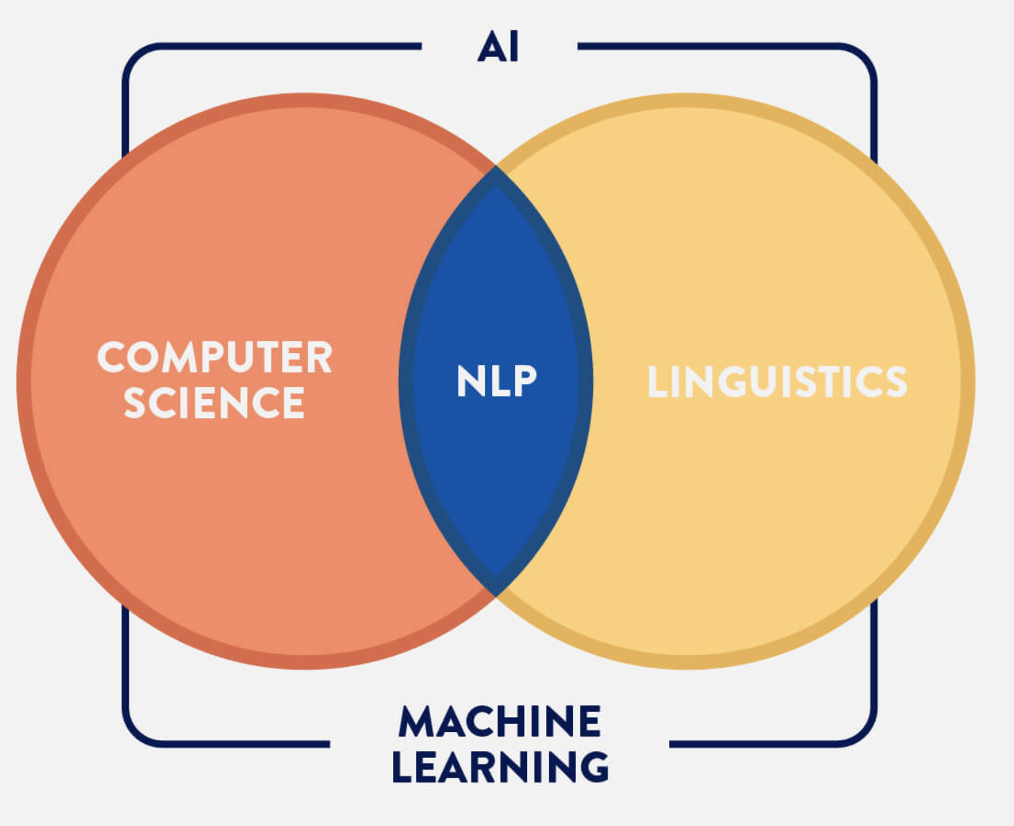
What is NLP?
“Natural language processing (NLP) is concerned with the interactions between computers and human languages, in particular how to program computers to process and analyze large amounts of natural language data.”
-- Wikipedia

Slide 30
What is Natural Language Understanding (NLU)?
What does a text really mean?
https://medium.com/sciforce/nlp-vs-nlu-from-understanding-a-language-to-its-processing-1bf1f62453c1
Understanding
Interpret meaning (e.g. dealing with common human errors like mispronunciations or transposed letters or words)
Natural Language
Processing
NLP
NLU

Slide 31
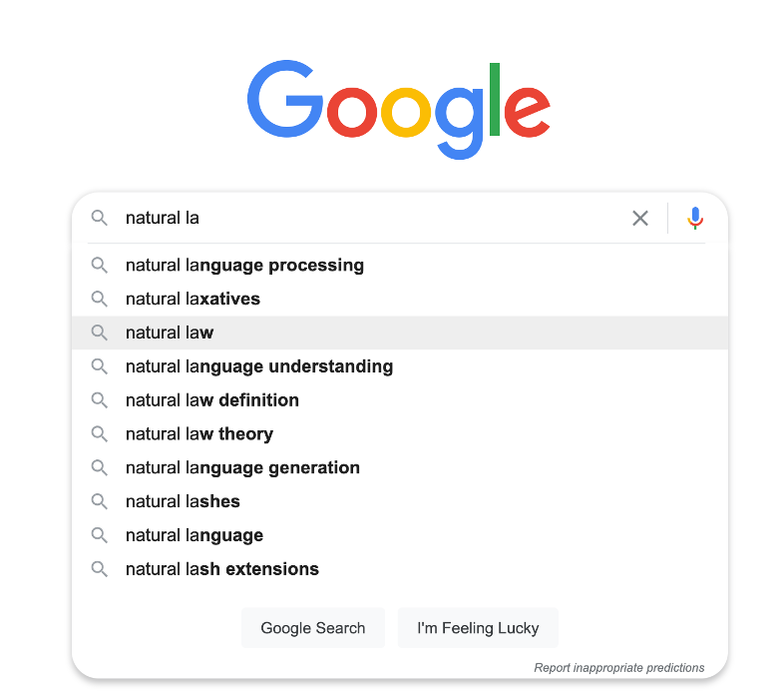
What is Natural Language Generation (NLG)?
Stands for Natural Language Generation
Turn structured data into text
Text can also be converted into a speech format through text-to-speech (TTS) services
Consider language rules based on
Morphology, lexicons, syntax and semantics
NLU
Text
Meaning
NLG

Slide 32
Terminology: NLU vs. NLP vs. NLG
NLP
Text Tagging
Text Classification
NLU
Named Entity Recognition
NLG
Sentiment Analysis
Text Pair Classification/Regression
Machine Translation
Text Summarization
Natural Language Inference
Question Answering

Slide 33
Deep NLP Overview
Three main components:
3. Application
Sentiment analysis (single text)
Natural language inference (text pairs)
. . .
Multi-layer Perceptron (MLP)
Convolutional Neural Network (CNN)
Recurrent Neural Network (RNN)
Attention
. . .
2. Architecture
word2vec
GloVe
Subword embedding
Bidirectional Encoder Representations from Transformers (BERT)
. . .
1. Pretraining
Notes:
This is a general overview for NLP in deep learning context. We will cover most of these concepts in this class.

Slide 34
Topics for Today
Introduction to Machine Learning
Introduction to NLP
Text Processing
Bag of Words (BoW) Representation
Single Layer Neural Networks
Final Project

Slide 35
Text Pre-Processing
Application
Sentiment Analysis
Architecture
One-layer Network
(Logistic Regression)
Multi Layer Perceptron
Vectorization
Bag of Words
Text
Pre-Processing
Tokenization + Stop Words Removal + Stemming/Lemmatization
Notes:
Today’s plan is this. Notice that we don’t have the pretraining step here. We will keep it simple and learn a technique called “Bag of Words”. This technique also needs our text to be cleaned and normalized (text pre-processing) beforehand.

Slide 36
Tokenization
Breaks text apart by white space and punctuation.
Example:
These tokens will be used in the next steps.
Sentence (input) | Tokens (output)
“I don’t like eggs.” | “I”, “do”, “n’t”, “like”, “eggs”, “.”
Notes:
Tokenization is a key part of text processing. Tokens are the smallest pieces of text data that we extract from documents. At the end, this process produces tokens by splitting the text by white space and punctuation. Note that this is very language specific. We only discuss English here.

Slide 37
Stop Words Removal
Stop words: Some words that frequently appear in texts, but they don’t contribute very much to the overall meaning.
Some example words: “a”, “the”, “so”, “is”, “it”, “at”, “in”, “this”, “there”, “that”, “my”
We remove these words.
Original Sentence | Sentence without stop words
“There is a tree near the house” | “tree near house”
Notes:
After tokenization, we now have tokens. In the stop words removal process, we have a list of stop words. These words are some frequent words that don’t contribute too much to the overall meaning of the text. We simply compare our tokens with this list and remove the tokens that are on the stop word list.

Slide 38
Stemming vs Lemmatization
Stemming and lemmatization are two techniques that convert words into their “base forms”.
Stemming
1. Simple set of rules to slice a string to a substring that usually refers to a more general meaning.
2. Some simple cases (it works): teaching->teach, worked->work, apples->apple
3. Some difficult cases (it doesn’t work): taught->taught, am->am, better->better
Lemmatization
1. Finding base forms through use of a vocabulary and morphological analysis (more advanced than stemming).
2. Some simple cases (it works): teaching->teach, worked->work, apples->apple
3. Some difficult cases (it works): taught->teach, am->to be, better->good
Notes:
Our next step is stemming/lemmatization. These two techniques aim to simplify our tokens. This is also sometimes called text normalization.
Stemming is a rule based method that creates some substrings that correspond to a simpler form of a given token. It simply removes the extras from the start or the end of token.
Lemmatization is more involved. It uses a grammatical approach and, therefore it can handle more difficult cases such as irregular forms. At the end, both of these methods produce simpler or more general meaning tokens.

Slide 39
Text Processing – Hands-on
In this exercise, we will go over:
Simple text cleaning processes
Stop words removal
Stemming, Lemmatization
MLA-NLP-DAY1-TEXT-PROCESS-NB.ipynb

